Slide 1
scRNA-seq Analysis
CDS-SR scRNA-seq Workshop 2022
(Section 1)
Seurat (Integration Pipeline)
Slide 1

Slide 2
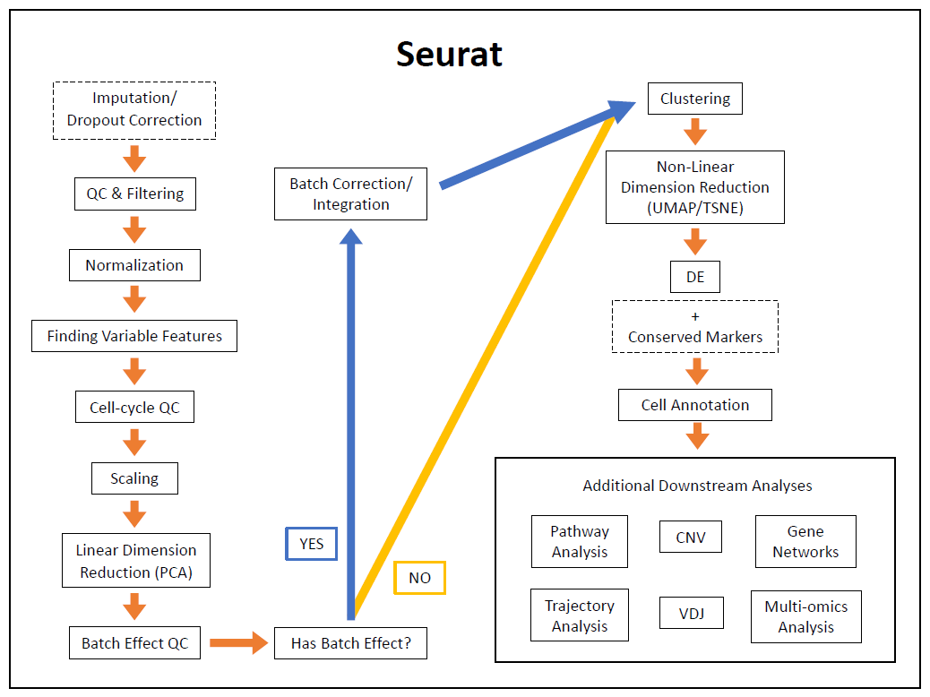
Slide
Notes:
Gone through majority of pipeline
Address elephant in the room, do we have batch effect and how to do I correct for it?
Go through integration pipeline

Slide 3
Batch Effect Analysis
Batch effects can come from technical and biological variation across samples
Can usually prevent with good experimental design, but sometimes not
Ex: unequal amplification during PCR, cell lysis, reverse transcriptome enzyme efficiency, sampling during sequencing
Can be fixed by multiplex, normalization, etc.
Slide 3
Notes:
Read all bullet points

Slide 4
Batch Effect Analysis
Batch effects can come from technical and biological variation across samples
Examples of when this might not be possible:
Sequencing on different days
Processing with different protocols (Chromium, Smart-seq2, CEL-seq2, etc.)
Sequenced on different technology platforms (10X, Nadia, etc.)
Looking at multiple publicly available datasets
Different tissues (lung vs. pancreas)
Different species (mouse, human, etc.)
Slide 4
Notes:
Read all bullet points

Slide 5
Batch Effect Analysis
How do tell if I have a batch effect or what is my batch variable?
Most know before analyzing the data
Can check with plots
Can check the DE tables
Usually when many mitochondrial and ribosomal genes are the top DE genes are
Slide 5
Notes:
Read all bullet points

Slide 6
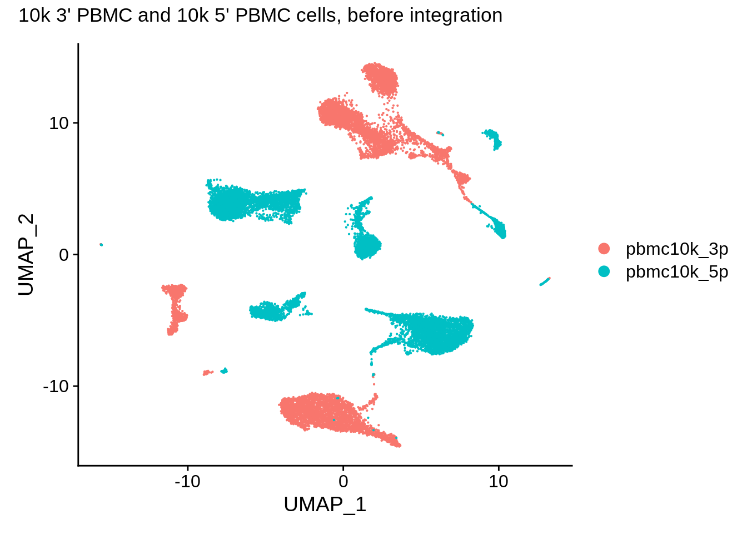
Batch Effect Analysis: Example
With batch effect by 3’ or 5’ end sequencing
Slide 6
https://www.singlecellcourse.org/scrna-seq-dataset-integration.html#practical-integration-of-real-datasets
Notes:
Example of end results if didn’t batch correct
Explain differences in sequencing
Explain plot and separation
want to see batches mix together

Slide 7
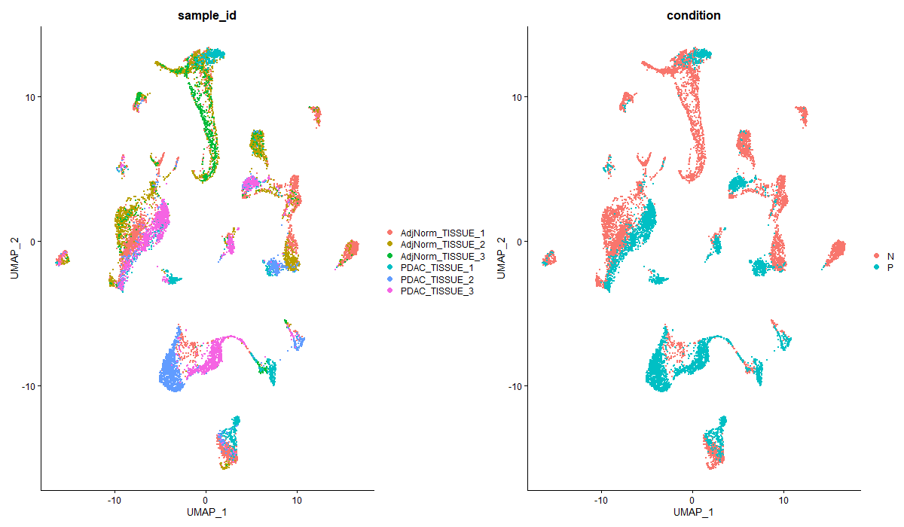
Batch Effect Analysis & Integration: Exercise
Is this dataset affected by batch? And by what variable?
Slide 7
Notes:
Read question
Choose among these two variables (can be multiple)

Slide 8
Batch Effect Analysis & Integration: Exercise (Answers)
Main batch effect variable = Sample ID
Also affected by when the samples were sequenced
Dates/batch # of when sequenced are not shown
Maybe by condition (but taken care of by Sample ID)
Slide 8
Notes:
Explain answers

Slide 9
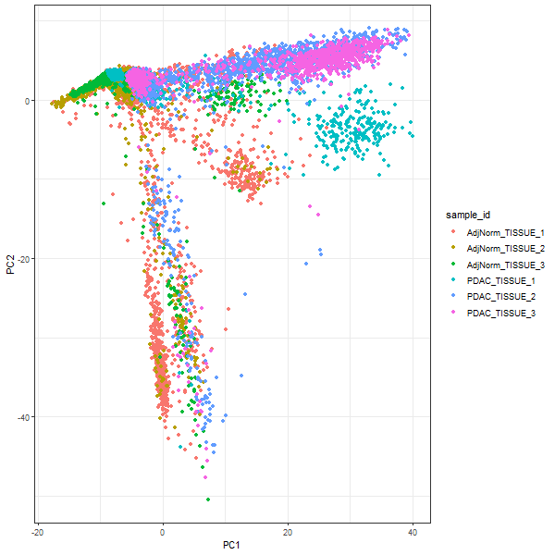
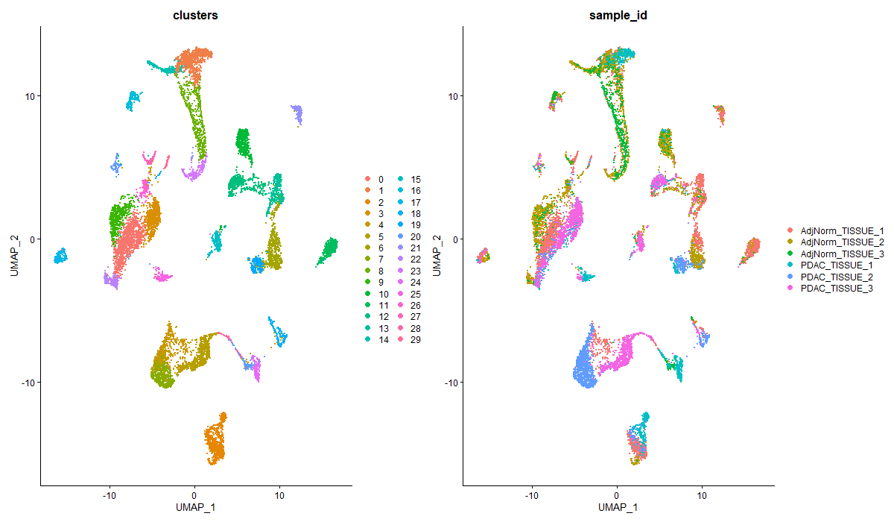
Batch Effect Analysis & Integration: Exercise (Answers)
PCA
UMAP
Slide 9
Notes:
Explain right plot (PCA)
Explain left plot (UMAP)

Slide 10
Batch Correction/Integration
Method to remove variation
Batch correction vs. Integration
Batch correction
Comes from bulk RNA-seq
Tools = ComBat, limma, ZINB-WaVE, etc.
Integration
Algorithms = mutual nearest neighbors (MNN), canonical correlation analysis (CCA), non-negative matrix factorization, neural networks, etc.
Tools = fastMNN, Seurat, LIGER, Harmony, Scanorama, etc.
Slide 10
Notes:
Read all bullet points
Show two different results using Seurat integration and Harmony

Slide 11
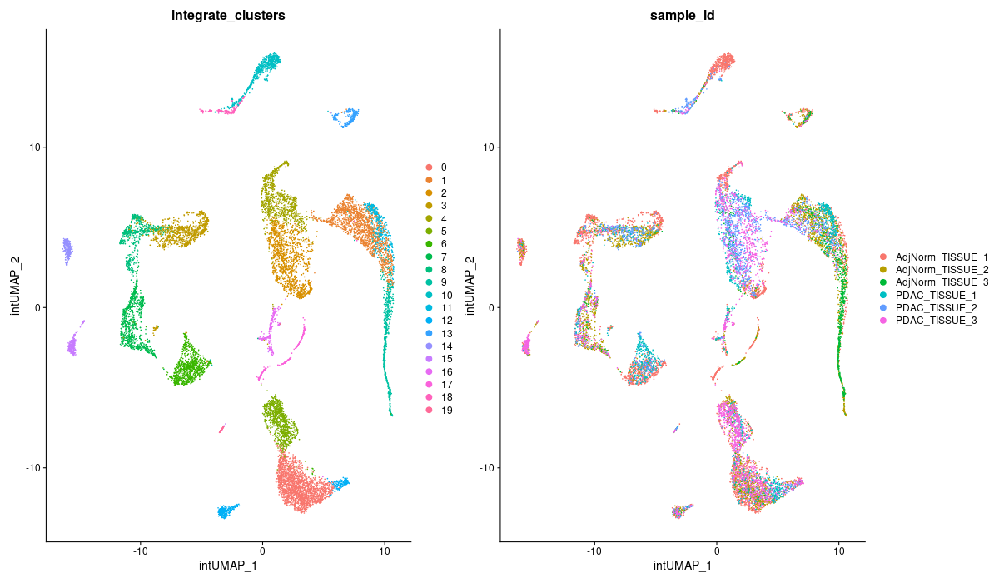
Batch Correction/Integration
Seurat Integration
Finds and uses anchors to align datasets/batches
Look at supplemental for more information on algorithm
Slide 11
Notes:
Read all bullet points
Explain plots on right; mixing of sample ids

Slide 12
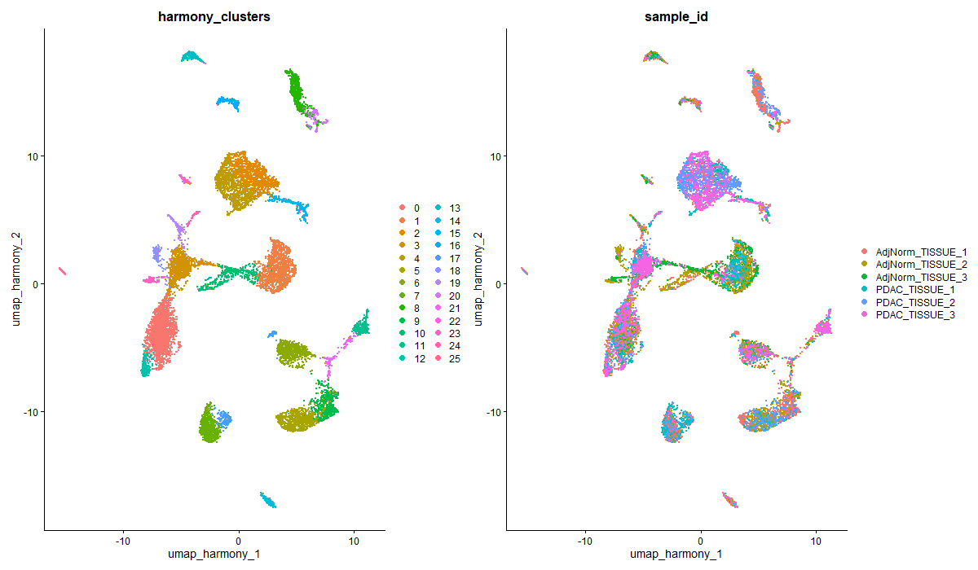
Batch Correction/Integration
Harmony
Uses soft clustering to align datasets/batches
Look at supplemental for more information on algorithm
Slide 12
Notes:
Read all bullet points
Explain plots on right; mixing of sample ids
UMAPs and clustering will be different depending on what tool used

Slide 13
Batch Correction/Integration
Which integration method is the best?
It depends!
# of cells (how large is your dataset?)
Memory usage and processing time
How easy is it to implement in pipeline?
https://genomebiology.biomedcentral.com/articles/10.1186/s13059-019-1850-9
Slide 13
Notes:
Read all bullet points

Slide 14
Batch Correction/Integration
Can I do DE with these batch corrected/integrated values?
NO, DON’T DO THIS!
Results will be based on the subset of genes that is used to correct/integrate
Lose variation = lose information
Better to include batch variable(s) as a covariate in testing model
Use normalized non-corrected data
Only use batch corrected/integrated values for visualizations and clustering
Slide 14
Notes:
Read all bullet points

Slide 15
Batch Correction/Integration
Methods to do DE with batched data
DE with covariate/latent variable in model
Test option with batch capabilities in Seurat = LR, negbiom, poisson, MAST, DESeq2
Can be too restrictive on results
Especially if have small # of cells
Conserved Markers Analysis
Can see how batch variables affects DE and decide which genes are actually important
Slide 14
Notes:
Read all bullet points

Slide 16
Slide 16
Notes:
Now skipping forward since clustering, dimension reduction, and DE steps are the same as in the standard pipeline

Slide 17
Conserved Markers Analysis
Find gene markers conserved among groups
Differential expression compared to other groups but have similar expression between groups that are actually compared
Ex: DE between normal and cancer samples in each batch
N vs. C in batch 1, N vs. C in batch 2, etc.
Finding genes that are different between normal and cancer conditions but similar/conserved among batches
Slide 17
Notes:
Think of this as specialized DE method
Read all bullet points

Slide 18
Conserved Markers Analysis
Useful when:
Want to know conserved genes between cell types
Ex: find cell type markers among conditions in myeloid populations
Working with a dataset with batch effect
Regular DE can be affected by batch effects
using normalized, not corrected data
Slide 18
Notes:
Read all bullet points
Don’t use integrated values

Slide 19
Conserved Markers Analysis: Output Table
Uses similar columns as in DE, but each “group” has its own values
Sample_1 = p_val, avg_log2FC, pct.1/2, p_val_adj
Sample_2 = p_val, avg_log2FC, pct.1/2, p_val_adj
New columns:
max_pval = largest p-value calculated by each group
minimum_p_val = combined p-value
calculated by metamap package
Slide 19
Notes:
Read all bullet points

Slide 20
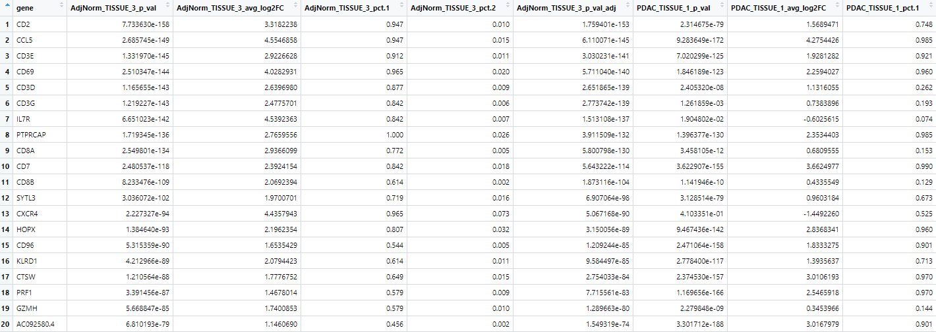
Conserved Markers Analysis: Output Table
20 Conserved Markers of cluster 0 (using Harmony)
Slide 20
Notes:
Example output table
point out that each sample id has own p_val, avg_log2FC, pct.1/2, and p_val_adj columns
explain first row

Slide 21
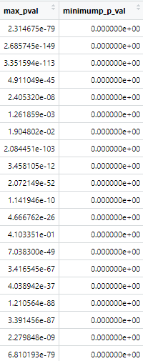
Conserved Markers Analysis: Output Table
20 Conserved Markers of cluster 0 (using Harmony)
Slide 21
Notes:
Two new columns

